Slide 1
IDDE and SWPPP Training 2024
Town of pelham,
New Hampshire

Slide 2
Illicit Discharge Detection and Elimination (IDDE)
Notes:
What is IDDE? Acronym
An illicit discharge detection and elimination program comes from the MS4 permit, issued by the EPA

Slide 3
Background on the MS4 Permit
What is a MS4?
A Municipal Separate Storm Sewer System (MS4) is composed of the structures within the town that either collect, convey, or outfall stormwater
Some examples of these structures include drain manholes, swales, catch basins, stormwater drainage basins, and culverts
Why is it called The Permit?
The Permit authorizes towns to discharge stormwater under the Clean Water Act and National Pollutant Discharge Elimination System (NPDES)

Slide 4
Illicit Discharge Informational Video
Illicit Discharge informational video can be found on the MCM #3 page of nh Ms4 website

Slide 5
Identifying Illicit Discharges
Intentional: dumping directly into catch basins or surface waters i.e., pet waste in catch basins or yard waste into surface waters​
Unsuitable Original Infrastructure: Old building floor drains connected to the storm drain system​
Obstruction of Municipal Storm Drain System: Any contractor or resident may not obstruct or interfere with the storm drain system without permission
If it hasn’t rained recently and there is a flow coming out of an outfall, that might indicate an illicit discharge is occurring.
Notes:
An illicit discharge is when something that isn’t stormwater enters the town’s stormwater drainage system – mainly catch basins or open surface water.

Slide 6
Allowable Non-Stormwater Discharges
Diverted stream flows​
Discharge from landscaped irrigation or lawn watering​
Waterline flushing and culvert/storm drain clearing​
Dye testing if verbal notification is given to the Town of Pelham and approval is received prior to testing​
Natural flows from riparian habitats and wetlands​
Uncontaminated groundwater infiltration​
Inconsequential amounts of discharge from normal street sweeping operations​
Discharges from non-commercial recreational water uses such as dechlorinated swimming pool water, hot tubs, and skating rinks​
Condensation from air conditioning
Rising groundwater/uncontaminated pumped groundwater​
Water from HVAC systems, basement and crawl space pumps, and foundations and footing drains (except for active groundwater dewatering systems like dewatering excavations for foundations or pipelines)​
Residential vehicle, household item, and house exterior washing​
Anything permitted under an NPDES permit, waiver, or a waste discharge order administered under the authority of the EPA or NHDES if the discharge is in full compliance​
Flow from potable water sources​
Irrigation water, springs​
Fire-fighting activities
Notes:
There are a lot of materials/situations that are exempt from being considered an illicit discharge. Some examples include ac condensation, firefighting materials/activities, irrigation or lawn watering discharge, and more

Slide 7
Addressing Illicit Discharges
One way is through outreach and education​
This can decrease the number of discharges by residents or contractors​
Eliminating some discharges could require substantial efforts and costs​
i.e., fixing failed septic systems

Slide 8
Legal Authority
Pelham adopted the Zoning Ordinance Article VIII-I known as the Illicit Discharge Detection and Elimination (IDDE) Ordinance​
Legal authority:​
Investigate suspected illicit discharges​
Prohibit illicit discharges​
Eliminate illicit discharges​
Create and enforce appropriate procedures and actions​
Pelham Planning Department is the lead municipal agency for IDDE implementation

Slide 9
Illicit Discharge Elimination
If an illicit discharge is detected, gather the following information:​
The method of discovery​
Location of the discharge and its source(s)​
Date of discovery​
Description of the discharge (pictures and videos are better for documenting)​
If known, the cause​
And send it to or call Dena immediately who will contact NHDES and the EPA

Slide 10
Any Questions About IDDE?

Slide 11
5 Minute Break
Notes:
Thank you to police and fire for coming! You are free to go, everyone else we still have to cover SWPPPs. Let’s meet back at blank time to start up again.

Slide 12
Stormwater Pollution Prevention Plans (SWPPP)

Slide 13
SWPPP Team 2024
Name | Position/Title | Phone Number | Email
Jenn Beauregard | Planning Director | 603-635-7811 | jbeauregard@pelhamweb.com
Dena Hoffman | Environmental Regulation Compliance Specialist | 603-508-3000 ext. 3101 | dhoffman@pelhamweb.com
Sean Cunningham | Cemetery Foreman | 603-635-6974 | scunningham@pelhamweb.com
Jim Hoffman | Highway Agent | 603-635-8526 | jhoffman@pelhamweb.com
Rhonda Whittier | Office Manager | 603-635-8526 | rwhittier@pelhamweb.com
Bob Long | Transfer Supervisor | 603-635-3964 | blong@pelhamweb.com
Brian Sands | Facilities Director | 603-635-9173 | bsands@pelhamsd.org
Karen Churchill | Administrative Assistant | 603-635-9173 | kchurchill@pelhamsd.org

Slide 14
Cemetery Department and Gibson Cemetery

Slide 15
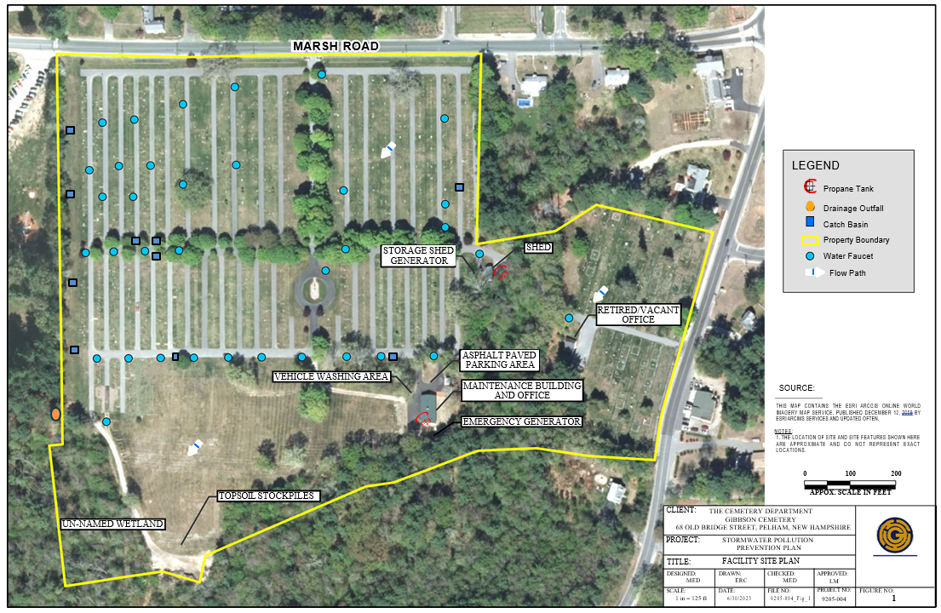
Cemetery Facility Site Plan

Slide 16
Potential Pollutant Sources
Activity # | Description | Potential Pollutants
1 | Maintenance Building Generator | Metal, Fuel Oil
2 | Maintenance Building Outdoor Propane Tank | Metal
3 | Storage Shed Generator | Metal, Fuel Oil
4 | Storage Shed Outdoor Propane Tank | Metal
5 | Retired / Vacant Office | None
6 | Solid Waste Dumpster | Municipal waste
7 | Mobile Trucks (i.e., Chevy Pickup Truck, Ford Dump Truck, Backhoe) | Metal, Residual Oil, and Total Suspended Solids
8 | Lawn Equipment | Residual Oil
9 | Asphalt Paved Roads and Parking Lot | Sand, Salt, Oil
10 | 5-gallon Gasoline Can | Gasoline
11 | Vehicle Washing | Residual Oil and Total Suspended Solids

Slide 17
Highway Department

Slide 18
Highway Department Facility Site Plan

Slide 19
Potential Pollutant Sources
Activity # | Description | Potential Pollutants
1 | Lawn Care/Landscaping (i.e., Chain Saws, Pole Saws, Weed Whackers, Blowers, Gas Compactors) | Fertilizer, Herbicides, Pesticide, Residual Oil
2 | Mobile Vehicles (i.e., Dump Trucks with Plows & Sanders, Pickups with Plows, JCB Backhoes, Loader, Town Car, Compactor Roller) | Metal, Residual Oil, and Total Suspended Solids
3 | Two 100-gallon Propane Tanks for Heaters | Metal
4 | One Woodchipper | Woodchips, Metal, Residual Oil
5 | Six 55 Gallon Open Oil Drums on Spill Pallets | Residual Oil, Metal
6 | Asphalt Paved Roads and Parking Lot | Sand, Salt, Oil
7 | Dirt Parking Lot | Oil, Total Suspended Solids
8 | Salt Shed | Salt
9 | Sand Pile | Sand
10 | Vehicle Washing | Total Suspended Solids, Residual Oil
11 | Antifreeze on Spill Pallets | Antifreeze
12 | Equipment/Vehicle Maintenance | Residual Oil

Slide 20
Pelham School District

Slide 21
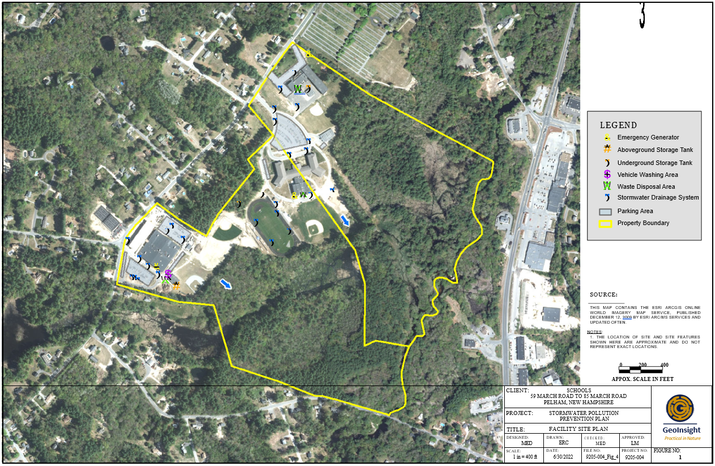
Pelham School District Site Plan

Slide 22
Potential Pollutant Sources
Pelham Elementary School
Activity # | Description | Potential Pollutants
1 | Lawn Care/Landscaping | Fertilizer, Herbicides, Pesticide
2 | 5-gallon Containers of Fuel Storage | Gasoline
3 | Quart-Sized Containers of Oil Storage | Lubricants/Grease, Motor Oil
4 | Two Solid Waste Dumpsters | Municipal waste
5 | Asphalt Paved Roads and Parking Lot | Sand, Salt, Oil
6 | Snow Removal | Sand, Salt
7 | Generator | Fuel Oil
Pelham High School
Activity # | Description | Potential Pollutants
1 | Lawn Care/Landscaping | Fertilizer, Herbicides, Pesticide
2 | 5-gallon Containers of Fuel Storage | Gasoline
3 | Quart-Sized Containers of Oil Storage | Lubricants/Grease, Motor Oil
4 | Two Solid Waste Dumpsters | Municipal waste
5 | Asphalt Paved Roads and Parking Lot | Sand, Salt, Oil
6 | Snow Removal | Sand, Salt
7 | Generator | Fuel Oil
8 | Maintenance Garage | Equipment Maintenance, Gasoline, Diesel, Antifreeze, Hydraulic Fluids, Lubricants/Grease, Motor Oil
Pelham Memorial School
Activity # | Description | Potential Pollutants
1 | Lawn Care/Landscaping | Fertilizer, Herbicides, Pesticide
2 | 5-gallon Containers of Fuel Storage | Gasoline
3 | Quart-Sized Containers of Oil Storage | Lubricants/Grease, Motor Oil
4 | Two Solid Waste Dumpsters | Municipal waste
5 | Asphalt Paved Roads and Parking Lot | Sand, Salt, Oil
6 | Snow Removal | Sand, Salt
7 | Generator | Fuel Oil

Slide 23
Transfer Station and Recycling Center

Slide 24
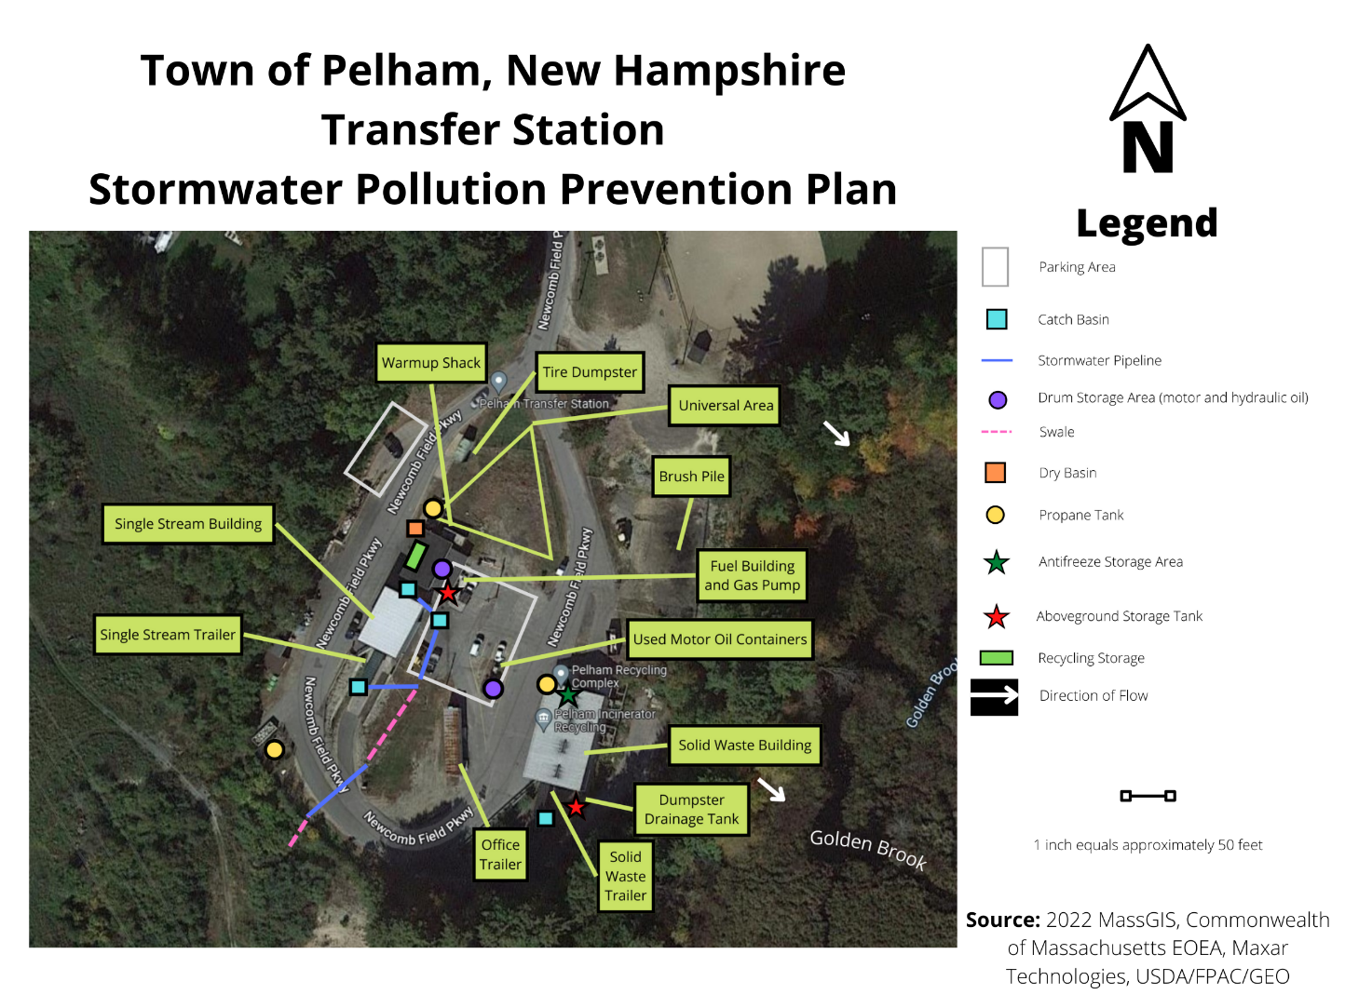
Transfer Station Facility Site Plan

Slide 25
Potential Pollutant Sources
Transfer Station
Activity # | Description | Potential Pollutants
1 | Mobile Vehicles (i.e., Chevy Pickup Truck w/Plow, JCB Backhoe, Bobcat Skid Steer, JCB Skid Steer) | Metal, Residual Oil, and Total Suspended Solids
2 | Two 75-yard Trash Trailers (Green) | Municipal waste
3 | One 100-yard Trash Trailer (Black) | Municipal waste
4 | Lawn Equipment (i.e., Push Lawn Mower, Weed Wacker, Gas Blower) | Residual Oil
5 | 1000-gallon Unleaded Gasoline Aboveground Storage Tank in a Cement Vault | Unleaded Gasoline
6 | 1000-gallon Diesel Aboveground Storage Tank Equipped with Pumps in a Cement Vault | Diesel
7 | Two 275-gallon Used Oil Aboveground Storage Tanks in Spill Containment Sump and Covered by a Roof | Used Oil, Metal
8 | Multiple 55-gallon Oil Drums on Spill Pallets | Oil, Metal
9 | Two 100-gallon Propane Tanks for Heaters | Metal
10 | Oil Filter Crusher | Oil, Metal
11 | Two Electric Conveyors | Municipal Waste
12 | Asphalt Paved Roads and Parking Lot | Sand, Salt, Oil
13 | Equipment/Vehicle Maintenance | Residual Oil
14 | Brush Pile | Organic Material
15 | Scrap Metal Stored in Uncovered 40-yard Roll-Off Containers | Metal
16 | Hazardous Material Storage Indoors on Oil Containment Pallets | Paint, Solvents, Cleaners, Antifreeze

Slide 26
Best Management Practices

Slide 27
Preventing Spills
Spill response equipment must be located at potential spill areas
01
Regularly inspect outdoor storage tank areas for leaks
02
Regularly check aboveground storage tanks for leaks or signs of corrosion
03

Slide 28
Spill Response
When a spill happens​
If possible, contain spills as close to the source as you can​
Create an embankment of absorbent materials located in the emergency spill kit​
A dam or covering the spill will protect stormwater intake structures such as catch basins​
Immediately alert one of the Pelham SWMP Coordinators of hazardous or regulated material spills

Slide 29
Maintenance and Repairs
Prevent or minimize exposure to stormwater runoff
1
Maintain or repair equipment either off-site or indoors
2
Keep drainage swales clear of obstructions and well-maintained
3
Minimize leaks in hydraulic mechanical equipment by keeping it in good repair
4
Properly store and label all containers, drains, materials, and tanks
5

Slide 30
Good Housekeeping Measures
Promptly clean and report chemical spills as required
When not in use, store lawn care materials indoors
Keep drums of oil closed except when being actively used
Use drip pans when changing fluids
Minimize drips/leaks by using spigots and funnels
Regularly sweep outdoor storage areas and keep free of damaged and/or leaking containers

Slide 31
Stormwater Runoff Management
Stormwater runs off from the site and flows into catch basins
Where practical, impervious areas are uncurbed to encourage sheet flow runoff to adjacent vegetated areas

Slide 32
Maintenance Measures
Stormwater control measures will be maintained in operating condition​
SWPPPs will be added to on-site documentation that has the schedule outlining preventative maintenance and details maintenance procedures​
Create backup practices and procedures in the case that a runoff event happens while a control measure is not working​
Erosion Control:​ No potential areas for erosion have been identified at any Pelham facility

Slide 33
Inspections

Slide 34
If an Issue is Found…
If during an inspection or at any time a control measure is determined to need a repair or has become ineffective, the control measure will need to be repaired or replaced as soon as practicable​
Preferably, it will be repaired or replaced before the next storm event

Slide 35
Recordkeeping
All records of inspections, maintenance services, trainings, and other required activities will be kept for a minimum of 5 years

Slide 36
Your Individual Role
Be aware of how your activities could impact the environment
1
Know and understand the permit requirements
2
Report spills to SWPPP team & follow through with response procedures
3
Notify SWMP coordinators if your activities change
4
Be aware of monitoring procedures
5
Be aware of inspection requirements
6

Slide 37
Any Questions About SWPPPs?

Slide 38
Thank you!

